Slide 1
Vessel Arrest & Custody Services An Overview G. Robert Toney May 2015
Notes:
Thank you.
Put together this 30 minute presentation to better explain what we do.
Encourage you to stop and ask questions along the way.

Slide 2
Corporate Overview
National Maritime Services
In US, substitute custodian commercial ship & yacht arrests (1991)
International custody management for mortgagee banks
Sale of commercial vessels
Storage of federally-seized vessels & aircraft (1994)
National Liquidators
Domestic recovery of pleasure yachts, aircraft & RVs (1988)
Sale of recovered collateral
30,000+ custody assignments to date
Significant legal community involvement
Notes:
Ship custody assignments derive from a variety of scenarios
Mortgage defaults
Voluntarily surrender & owner abandonment
Unpaid bills resulting in vendor arrest
Security for arbitration or other claims
Government seizure for illegal activities
National obtains assignment referrals from a diverse group:
Shipping banks & other lenders
Admiralty lawyers
Necessaries providers such as bunkers suppliers
Governmental agencies
Performed these services for 25+ years, established a global network of contacts in many jurisdictions:
Relationships with key government officials - United States, UK, Singapore
Admiralty attorneys in major arrest jurisdictions - Panama, Gibraltar, South Africa
Network of marine suppliers, port agents, insurers and sales and purchase brokers
Our sister company recovers and sells in excess of 1,200 pleasure yachts annually in the US.

Slide 3
Custody Assignment Evaluation & Goals
Preliminary evaluation
Determine required resources
Nature of arrest claim
Ship’s value
Claimant creditworthiness
Goals
Ensure safety of vessel, cargo & crew
Control costs
Preserve/enhance vessel value
Prevent additional claims
Notes:
Mortgage enforcement assignments, we work with lender and their legal counsel at inception of assignment to determine best course of action.
Critical considerations:
Amount of mortgage, vessel status, condition & value
Resource requirements
Other known or potential claims
Consider current/expected location of vessel – is it beneficial to lender’s interests
Priority of other liens in relation to mortgage – varies from country to country
Bond requirements
Predictability and speed of legal system
Exposure to heavy weather
Owner’s likely action/inaction, Affect on other lender relationships
Market conditions
Exit strategy
Consider various alternatives
Judicial mortgage foreclosure in present/expected located
Self-help recovery (if permitted) and relocate to preferred jurisdiction for subsequent foreclosure
Execute stock power (if available), take control of vessel ownership
Right of offset or cross-collateralization
Disposition options
Sell
Operate
Once decision made, NMS work with lender to coordinate custody assignment
Provide budget
Preparation of court documents
Interact with government authorities to discuss timing. Assume custody lawfully & peacefully
Arrange required sources

Slide 4
Vessel Arrest Services
Discreet vessel tracking/location
On-board licensed watchman/keeper
Crew assessment
Insurance
Negotiate dockage/shift to anchorage
Fuel, provisions & other necessaries
Cargo & passenger discharge
Court reporting & expert witness
Interaction with authorities
Vessel sales
Post-sale management
Custody Costs
Money
Spent
Time
Notes:
Our custody services are provided a la carte on an as-needed basis
Graph indicates that expense run rate decreases over time as savings opportunities are implemented
Provide watchman, experienced USCG-licensed seamen.
Experience in triage/delicate situations
Watches out in best interest of claimants
Live on vessel
Interact with crew
Assess crew, look at status of necessary insurance - Discuss both further in a moment
Provide other necessary services such as
Crew provisions, bunkers, less-expensive dockage, garbage removal, critical maintenance
Arrange for discharge of cargo
Cargo subject to spoilage, passengers
Communicate with local authorities
Ability to interact in variety of jurisdictions
Discuss vessel safety concerns and immigration issues
Initiate discussions before communication problems develop
Not legal representatives, takes edge off
Pre-established relationships with authorities – Singapore (Chief Bailiff), UK (Admiralty marshal) and US (Marshal’s Service)
Arrange to maintain current classifications/enhance value at sale
And ultimately assist in promoting sale and identifying viable bidders
(to discuss further in a moment)
In summary, variety of potential cost saves:
Reduce or eliminate existing crew
Utilize watchman in lieu of security service
Negotiate for required services or with other claimants
Move vessel to/from anchorage/berth
Adjust insurance coverage
Eliminate technical manager

Slide 5
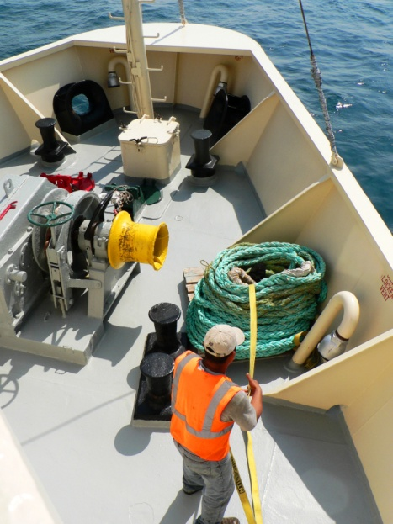
Crew Evaluation
Obtain crew list, pay records, contracts
Assess loyalty of master & crew
Clear medical issues
Determine & maintain proper immigration status
Crew reduction/cost savings opportunity
Honor safe manning requirements
Repatriate
Notes:
We prefer to retain existing crew to extent practical
Knowledge of vessel
Reduces travel/repatriation expense
Key to success - develop positive relationship
Display sensitivity to their needs
Listen to needs, keep informed, feed, allow to communicate with family
Initially explain our role and status of ship – provide interpreter(s) if necessary
Assess master’s loyalty, generally crew to follow
Confirm immigration status is legal/identify upcoming issues
Identify medical issues
Provide assistance
Establish liable party for maintenance and cure
Compile employment info
Who is on board
What are they paid
When were they paid last
Other issues such as severance
Finally, work with authorities to reduce/repatriate crew as cost-savings

Slide 6
Insurance Matters
Owner’s existing coverage
Payment status of premiums/calls
Affect of arrest/seizure
Naming additional insured(s)
Replacement coverage
Custodian’s liability
Hull & machinery, P&I, pollution
Relocation/final transit and port risk
Fixed premium/Limited term
Notes:
Often overlooked prior to our engagement in custody cases
Owner’s existing coverage
Payment status of premiums/calls
Affect of arrest/seizure
Naming additional insured(s) – bank, National
Replacement coverage
Custodian’s liability
Hull & machinery, P&I, pollution
Relocation/final transit and port risk
Fixed premium/Limited term
We have pre-established relationships with insurance providers
Fixed premium reduces exposure to unknown charges
Limited term reduces costs as policy can be written for as little as 30 days

Slide 7
Preparation For Court Sale
Monitor initial inquiries – grapevine
Accumulate list of likely bidders
Survey & complete specifications
Utilize crew to assist
Promote, promote, promote
Claimant’s protective bid strategy
Notes:
Often overlooked prior to our engagement in custody cases
Owner’s existing coverage
Payment status of premiums/calls
Affect of arrest/seizure
Naming additional insured(s) – bank, National
Replacement coverage
Custodian’s liability
Hull & machinery, P&I, pollution
Relocation/final transit and port risk
Fixed premium/Limited term
We have pre-established relationships with insurance providers
Fixed premium reduces exposure to unknown charges
Limited term reduces costs as policy can be written for as little as 30 days

Slide 8
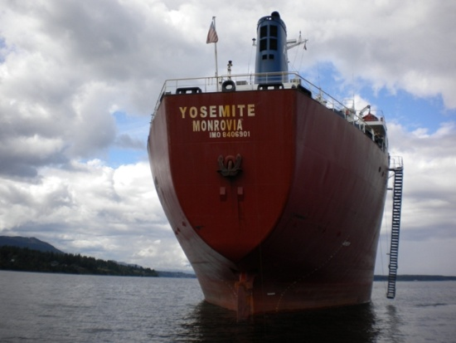
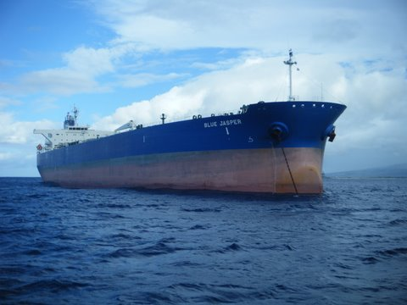
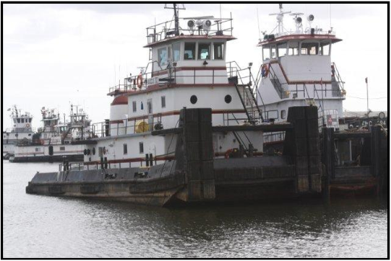
Representative Ship Sales
M/V Yosemite
28,019 dwt bulk carrier
Eastwind bankruptcy asset
Canadian auction & location
Utilized crew to make ship “sale ready”
Oversaw court sale & staffed auction
$6 million+ sales price
M/T Blue Jasper
105,905 dwt Aframax tanker
NMS court-appointed custodian
Collaborated with another S&P broker
Validated commercial reasonableness
$42.5 million sales price
Accumarine Assets
5 Inland push boats
8 Double skin tank barges
2 locations (AL & TX)
Sold at auction & post-sale
6 different buyers
$7 million+ cumulative price
Notes:
Sales opportunities/strategies
Work with lender to accumulate likely buyers/monitor inquiries – grapevine
Utilize crew to make vessel sale ready/accommodate visitors
Watchman provides feedback
Yosemite
Older build, bulk carrier
Part of Eastwind bankruptcy
Canadian auction & location
As custodians, we paid & utilized crew to make ship “sale ready”
Collaborated with another S&P broker to promote sale
Ran auction
Over 30 attendees/10 active bidders
$6 million+ sales price
Yosemite sales price exceeded independent valuation by approximately 25%
Blue Jasper
Newer build, 105,905 dwt Aframax tanker
Hawaii location
Mortgagee bank had prearranged sale
Hired us to promote auction and validate commercial reasonableness
$42.5 million sales price
Accumarine Assets
Specialized assets, specific to utilization on US inland rivers
Older collateral, in various stages of disrepair
5 Inland push boats & 8 Double skin tank barges
Situated in two jurisdictions
Sold at auction & post-sale to 6 different buyers
$7 million+ cumulative price

Slide 9
Custody Case Studies

Slide 10
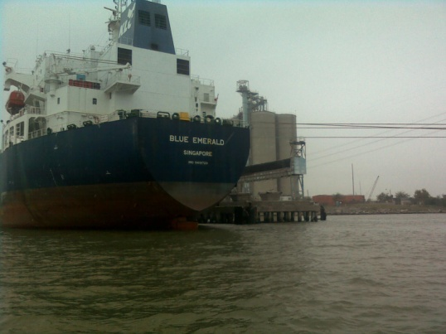
M/V Blue Emerald
51,332 dwt product tanker, 2009 build, Singapore registry
Ship mortgage foreclosure - Korea Line (Singapore)
Houston, Texas, USA location
80 day custody period
Reduced crew to minimum safe manning
Arranged short-term port risk insurance and P&I coverage
Negotiated less-expensive berth
Resolved complicated crew pay issues - diverse group of claimants
Managed crew injury claim – maintenance & cure
Assisted in vessel transfer to subsequent owner
Notes:
Blue Emerald is one of three Korean line vessels that we had custody of
Hired by mortgagee bank NORDEA
Ship mortgage foreclosure - Korea Line (Singapore)
Houston, Texas, USA location
80 day custody period
Reduced crew from 24 persons to 12 minimum safe manning
Arranged short-term port risk insurance and P&I coverage
Negotiated less-expensive berth – from $5,000 per day to $2,000
Diverse group of claimants
Petitioned court to honor crew contract
Managed crew injury claim – maintenance & cure
Assisted in vessel transfer to subsequent owner

Slide 11
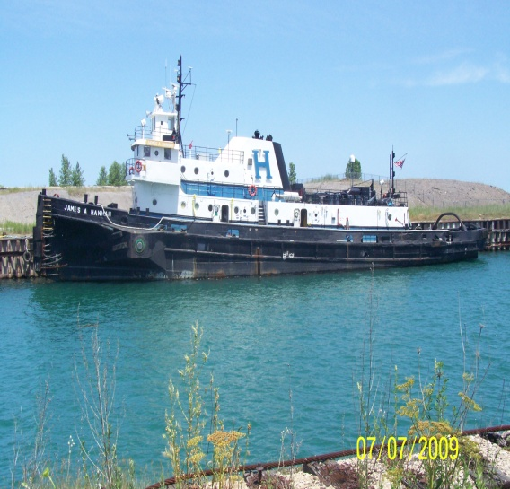
Hannah Marine Fleet
Fleet of 12 tugs & 9 barges
Retained by mortgagee bank
Cooperative owner surrendered vessels
Collateral located in 4 different jurisdictions
Provided security, dockage, maintenance, port risk & COFR
Substantial interaction with US Coast Guard
Other liens necessitated subsequent arrest and judicial sale
Notes:
Hannah Marine Fleet
Fleet of 12 tugs & 9 barges
Retained by mortgagee bank after cooperative owner surrendered vessels
Collateral located in 4 different jurisdictions
Provided security, dockage, maintenance, port risk & COFR
The USCG involvement particularly interesting.
Owner ignored issues CG had been raising.
Potential $30,000 daily fine.
Pumped off hazardous fluids of barges; installed booms
Dewatered and shifted ballast in listing barge
Created heavy weather plan
Bank ultimately arrested to clear liens and sold to predetermined buyer

Slide 12
F/V Lady Elizabeth
35 meter commercial fishing vessel, 2000 build, US flag
Retained by mortgagee bank
Self-help recovery, located in Costa Rica
Negotiated release from other Costa Rican claimants
Relocated to favorable jurisdiction for arrest & judicial sale
Notes:
F/V Lady Elizabeth
Of particular significance is we negotiated release while in Costa Rica
Provided our own crew to relocate to favorable jurisdiction

Slide 13
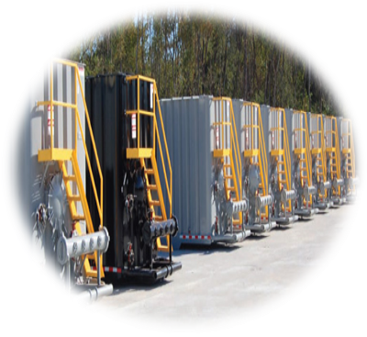
Ikaria Maritime Attachment
Claim resulted from CCNI Antartico accident in Ecuador
Simultaneous bunkers & container attachments in 4 ports
Determined port arrival details of each ship
Confirmed ownership of recent bunker purchases
Developed plan to offload and store bunkers
Claimant received alternate collateral quickly
Notes:
Finally, cruise ship Regal Empress
Difficult custody assignment in terms of coordination and resources
As a general rule, don’t seize cruise ships with passengers on board
Hired by ship vendor who hadn’t been paid for service to engines, arrested on first day of voyage
Kept 1,000+ passengers calm, while crew got them offloaded and onto buses, with luggage
Required us to liaise with ship officer’s and their crew
Later repatriated entire hotel/services crew of 260.
Escorts required – 21 different countries
UK, Honduras, Australia, Canada, US, Indonesia, Tunisia, Portugal, Philippines, Various Caribbean Islands, Romania, El Salvador, Guyana, Bulgaria, Lithuania, Nicaragua, Panama, India, Malaysia, Korea, Peru,
Keep immigration and Naturalization apprised of situation

Slide 14
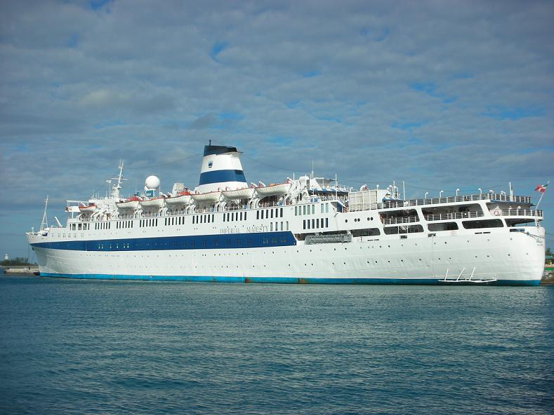
M/S Regal Empress
1,475 passenger cruise ship, 900 crew, 1953 build, 1983 refit
Necessaries claim
57 day custody period
Significant communication to ensure ship officer’s assistance
Offload of 1.000+ passengers & luggage, return transportation
Repatriated 260 crew, provided escorts for immigration purposes
Considerable interaction with INS (immigration officials)
Notes:
Finally, cruise ship Regal Empress
Difficult custody assignment in terms of coordination and resources
As a general rule, don’t seize cruise ships with passengers on board
Hired by ship vendor who hadn’t been paid for service to engines, arrested on first day of voyage
Kept 1,000+ passengers calm, while crew got them offloaded and onto buses, with luggage
Required us to liaise with ship officer’s and their crew
Later repatriated entire hotel/services crew of 260.
Escorts required – 21 different countries
UK, Honduras, Australia, Canada, US, Indonesia, Tunisia, Portugal, Philippines, Various Caribbean Islands, Romania, El Salvador, Guyana, Bulgaria, Lithuania, Nicaragua, Panama, India, Malaysia, Korea, Peru,
Keep immigration and Naturalization apprised of situation

