Slide 1
Commercial Vessel Arrest A Ship Custodian’s Perspective

Slide 2
Company Profile
National Maritime Services
Substitute custodian for domestic ships & yacht arrests
International custody management for mortgagee banks
Sale of commercial vessels
Storage of federally-seized vessels & aircraft
National Liquidators (affiliate)
Domestic recovery of pleasure yachts & aircraft
Sale of recovered collateral

Slide 3
Long-term Business Relationships
National Maritime Services maintains relationships with a diverse referral base
Mortgagee banks
Admiralty attorneys
Necessaries providers
Government agencies

Slide 4
Initial Reason for Arrest/Attachment
Yachts
Commercial Ships

Slide 5
Mortgage Enforcement Options
Preliminary evaluation
Assess various scenarios
Determine best course of action
Judicial foreclosure
Self-help & relocation to preferential jurisdiction
Contractual remedies
Execute stock power/convey ownership
Right of offset
Asset disposition – sell or operate

Slide 6
Custody Assignments
Evaluation
Determine required resources
Estimate ship value
Consider nature of claim
Assess creditworthiness of parties
Goals
Ensure safety of vessel & crew
Control costs
Preserve/enhance vessel value
Prevent additional liens

Slide 7
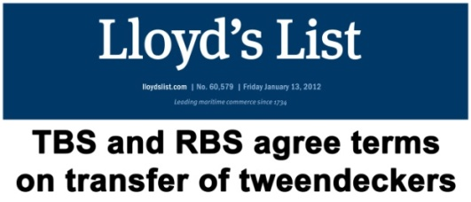
Voluntary Surrender/Abandonment
Immediately take custody of asset
Existing ship manager is likely conflicted
Negotiate lien releases with priority claimants
Determine long-term plan – sell or operate
Vessel Sale
Wind down existing operation
Vessel relocation & layup
Judicial sale to cleanse title
Create sales plan
Continue Operating Vessel
Keep asset off lender’s balance sheet
Utilize SPVs (on shelf, if needed)
Avoid equitable subordination claims
Hire competent manager for long term

Slide 8
A Variety of Custody Services
Discreet vessel tracking
On-board licensed watchman
Crew assessment
Insurance
Provisions, bunkers, dockage & shifting
Cargo & passenger discharge
Interaction with local authorities
Maintain classifications/certifications
Vessel sales
Custody Costs
Money
Spent
Time

Slide 9
Crew Evaluation
Utilize existing crew when feasible
Assess loyalty of master & crew
Determine immigration status
Identify existing medical issues
Compile employment contract information
Identify unnecessary crew/repatriate

Slide 10
Insurance Issues
Owner’s existing coverage
Payment status of premiums/calls
Affect of arrest/seizure
Naming additional insured(s)
Replacement coverage
Custodian’s liability
Hull & machinery, P&I, pollution
Relocation/final transit and port risk
Fixed premium/Limited term

Slide 11
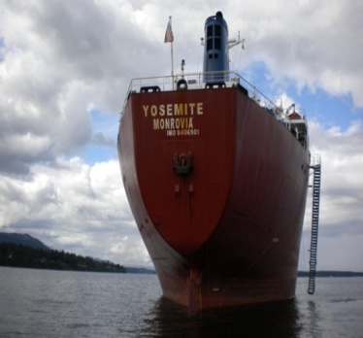
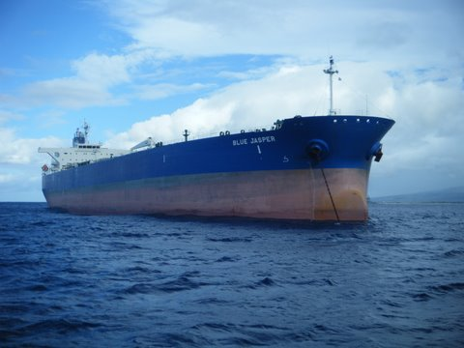
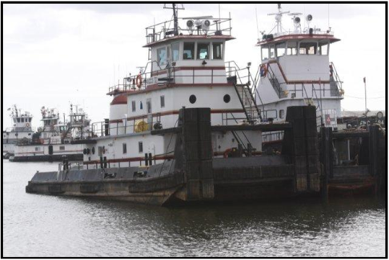
Representative Ship Sales
M/V Yosemite
28,019 dwt bulk carrier
Eastwind bankruptcy asset
Canadian auction & location
Utilized crew to make ship “sale ready”
Oversaw court sale & staffed auction
$6 million+ sales price
M/T Blue Jasper
105,905 dwt Aframax tanker
NMS court-appointed custodian
Collaborated with another S&P broker
Validated commercial reasonableness
$42.5 million sales price
Accumarine Assets
5 Inland push boats
8 Double skin tank barges
2 locations (AL & TX)
Sold at auction & post-sale
6 different buyers
$7 million+ cumulative price

Slide 12
Custody Case Examples

Slide 13
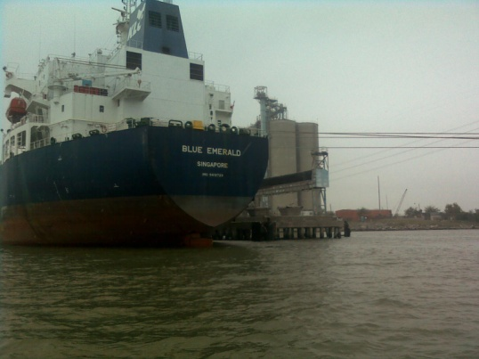
M/V Blue Emerald
51,332 dwt product tanker, 2009 build, Singapore registry
Ship mortgage foreclosure - Korea Line (Singapore)
Houston, Texas, USA location
80 day custody period
Reduced crew to minimum safe manning
Arranged short-term port risk insurance and P&I coverage
Negotiated less-expensive berth
Resolved complicated crew pay issues - diverse group of claimants
Managed crew injury claim – maintenance & cure
Assisted in vessel transfer to subsequent owner

Slide 14
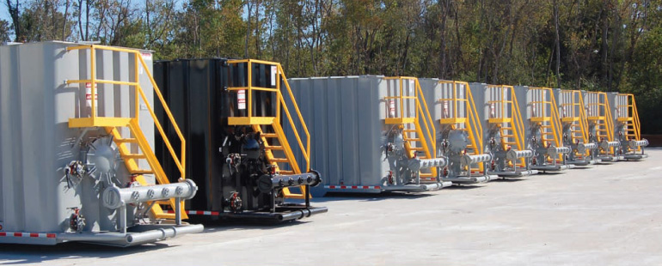
Ikaria Maritime Attachment
Claim resulted from CCNI Antartico accident in Ecuador
Simultaneous bunkers & container attachments in 4 US ports
Determined port arrival details of each ship
Confirmed recent bunker purchases
Developed plan to offload and store bunkers
Claimant received alternate collateral quickly

Slide 15
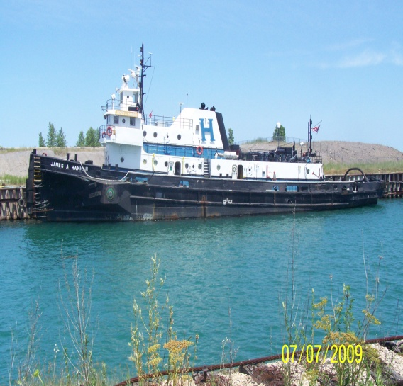
Hannah Marine Fleet
Fleet of 12 tugs & 9 barges
Retained by mortgagee bank
Cooperative owner surrendered vessels
Collateral located in 4 different jurisdictions
Provided security, dockage, maintenance, port risk & COFR
Substantial interaction with US Coast Guard
Other liens necessitated subsequent arrest and judicial sale

Slide 16
F/V Lady Elizabeth
35 meter commercial fishing vessel, 2000 build, US flag
Retained by mortgagee bank
Self-help recovery, located in Costa Rica
Negotiated release from other Costa Rican claimants
Relocated to favorable jurisdiction for arrest & judicial sale

Slide 17
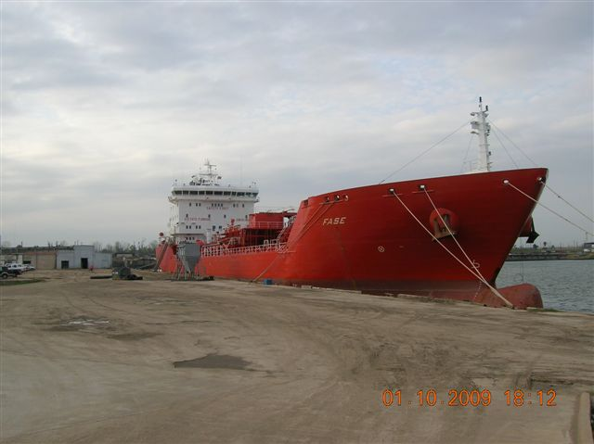
M/T Fase
16,750 dwt combined oil & chemical tanker, 2004 build, Liberia flag
Ship mortgage foreclosure
Located in Houston, Texas, USA
121 day custody period
Required bio-diesel cargo offload/hired additional AMO crew
Completed life raft certification to enhance value
Mortgagee acquired at auction (credit bid) & continued trading

Slide 18
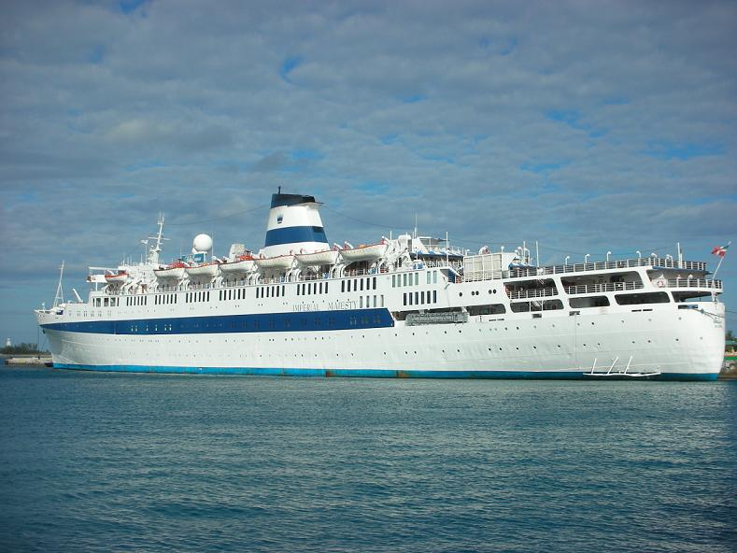
M/S Regal Empress
1,475 passenger cruise ship, 900 crew, 1953 build, 1983 refit
Necessaries claim
57 day custody period
Significant communication to ensure ship officer’s assistance
Offload of 1.000+ passengers & luggage, return transportation
Repatriated 260 crew, provided escorts for immigration purposes
Considerable interaction with INS (immigration officials)

Slide 19
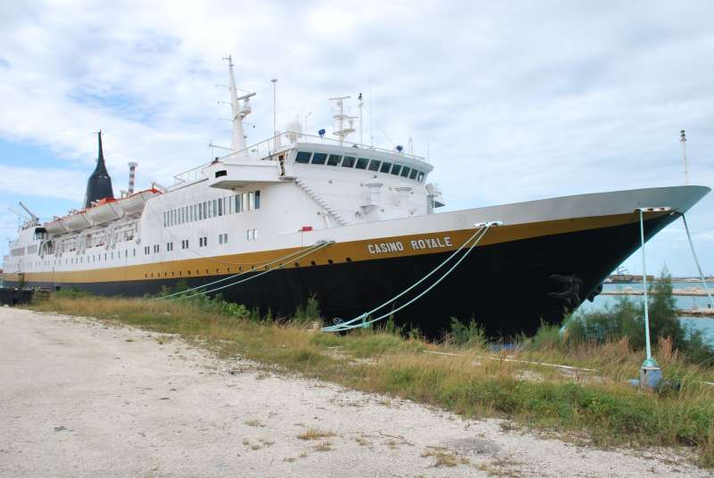
M/V Casino Royale Arrest
178 cabin gaming cruise ship, 1975 build, Bahamas flag
Located in Bahamas/retained by Bahamian Admiralty Marshal
Required significant interaction with Bahamian government
Alternative claims to gaming equipment
Repatriated unnecessary crew
Contingency case
Vessel ultimately sold as scrap

Slide 20
Recent Events Affecting Arrest
Move towards traditional Rule B attachments
Shippers filing Chapter 11

