Slide 1
Commercial Vessel Arrest A Ship Custodian’s Perspective

Slide 2
Company Profile
National Maritime Services
In US, substitute custodian for ship & yacht arrests
International custody management for commercial ships
Assist with sale of commercial vessels
Storage of seized vessels & aircraft for US government agencies
National Liquidators (affiliate)
US recovery of pleasure yachts & aircraft
Sale of recovered collateral

Slide 3
Long-term Business Relationships
National Maritime Services maintains relationships with a diverse referral base
Mortgagee banks
Admiralty attorneys
Necessaries providers
Government agencies

Slide 4
Custody Assignments
Evaluation
Nature of claim/type of arrest
Required resources
Ship’s value
Creditworthiness of claimant
Required deposit
Goals
Ensure safety of vessel & crew
Control costs
Preserve/enhance vessel value
Prevent additional liens

Slide 5
Voluntary Surrender/Abandonment
Immediately take custody of asset
Existing ship manager is likely conflicted
Negotiate lien releases with priority claimants
Allows time to develop best long-term plan
Liquidate
Continue to operate

Slide 6
A Variety of Custody Services
Discreet vessel tracking
On-board licensed watchman
Crew assessment
Insurance
Provisions, bunkers, dockage & shifting
Cargo & passenger discharge
Interaction with local authorities
Maintain classifications/certifications
Vessel sales
Custody Costs
Money
Spent
Time

Slide 7
Crew Evaluation
Utilize existing crew when feasible
Assess loyalty of master & crew
Determine immigration status
Identify existing medical issues
Compile employment contract information
Identify unnecessary crew/repatriate

Slide 8
Insurance Issues
Owner’s existing coverage
Payment status of premiums/calls
Affect of arrest/seizure
Naming additional insured(s)
Replacement coverage
Custodian’s liability
Hull & machinery, P&I, pollution
Relocation/final transit and port risk
Fixed premium/Limited term

Slide 9
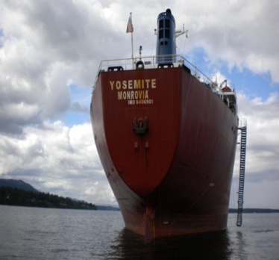
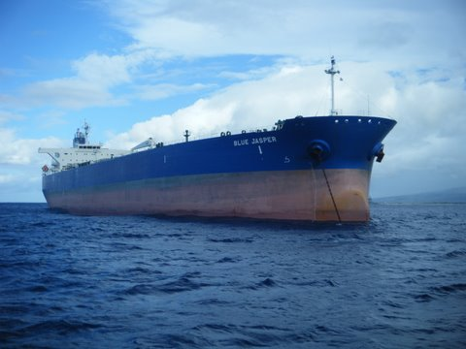
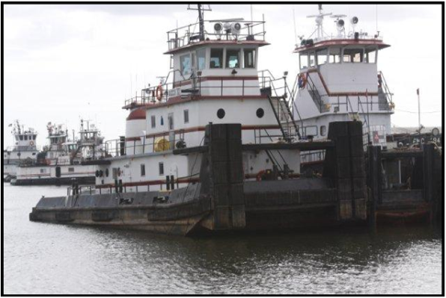
Representative Ship Sales
M/V Yosemite
28,019 dwt bulk carrier
Eastwind bankruptcy asset
Canadian auction & location
Utilized crew to make ship “sale ready”
Oversaw court sale & staffed auction
$6 million+ sales price
M/T Blue Jasper
105,905 dwt Aframax tanker
NMS court-appointed custodian
Collaborated with another S&P broker
Validated commercial reasonableness
$42.5 million sales price
Accumarine Assets
5 Inland push boats
8 Double skin tank barges
2 locations (AL & TX)
Sold at auction & post-sale
6 different buyers
$7 million+ cumulative price

Slide 10
Custody Case Examples

Slide 11
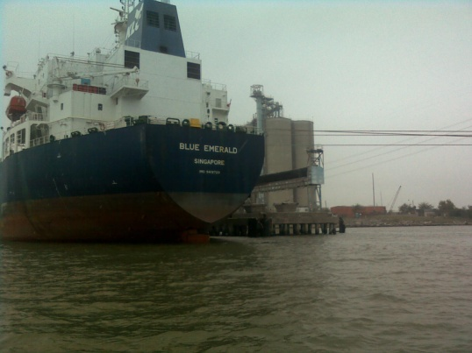
M/V Blue Emerald
51,332 dwt product tanker, 2009 build, Singapore registry
Ship mortgage foreclosure - Korea Line (Singapore)
80 day custody period
Reduced crew to minimum safe manning
Arranged short-term port risk insurance and P&I coverage
Negotiated less-expensive berth
Resolved complicated crew pay issues - diverse group of claimants
Managed crew injury claim – maintenance & cure
Assisted in vessel transfer to subsequent owner

Slide 12
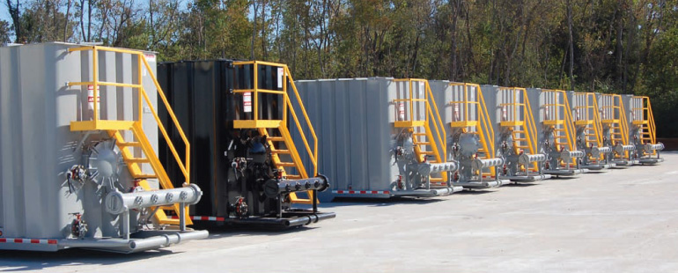
Ikaria Maritime Attachment
Claim resulted from CCNI Antartico accident in Ecuador
Simultaneous bunkers & container attachments in 4 ports
Determined port arrival details of each ship
Confirmed recent bunker purchases
Developed plan to offload and store bunkers
Claimant received alternate collateral quickly

Slide 13
F/V Lady Elizabeth
35 meter commercial fishing vessel, 2000 build, US flag
Retained by mortgagee bank
Self-help recovery, located in Costa Rica
Negotiated release from other Costa Rican claimants
Relocated to favorable jurisdiction for arrest & judicial sale

Slide 14
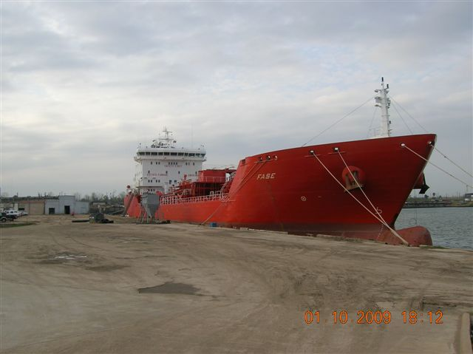
M/T Fase
16,750 dwt combined oil & chemical tanker, 2004 build, Liberia flag
Ship mortgage foreclosure
Located in Houston, Texas, USA
121 day custody period
Required bio-diesel cargo offload/hired additional AMO crew
Completed life raft certification to enhance value
Mortgagee acquired at auction (credit bid) & continued trading

Slide 15
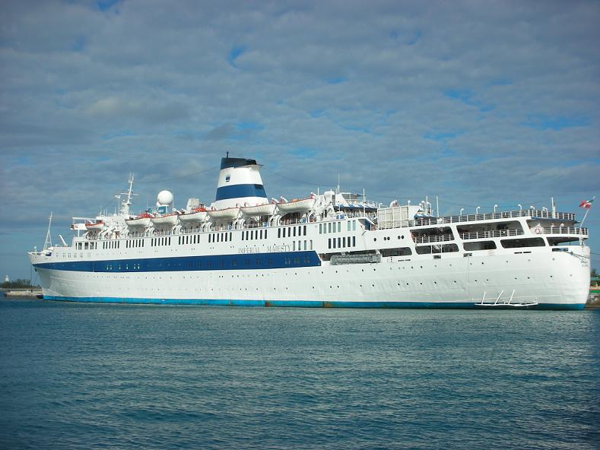
M/S Regal Empress
1,475 passenger cruise ship, 900 crew, 1953 build, 1983 refit
Necessaries claim
57 day custody period
Significant communication to ensure ship officer’s assistance
Offload of 1.000+ passengers & luggage, return transportation
Repatriated 260 crew, provided escorts for immigration purposes
Considerable interaction with INS (immigration officials)

