Slide 1
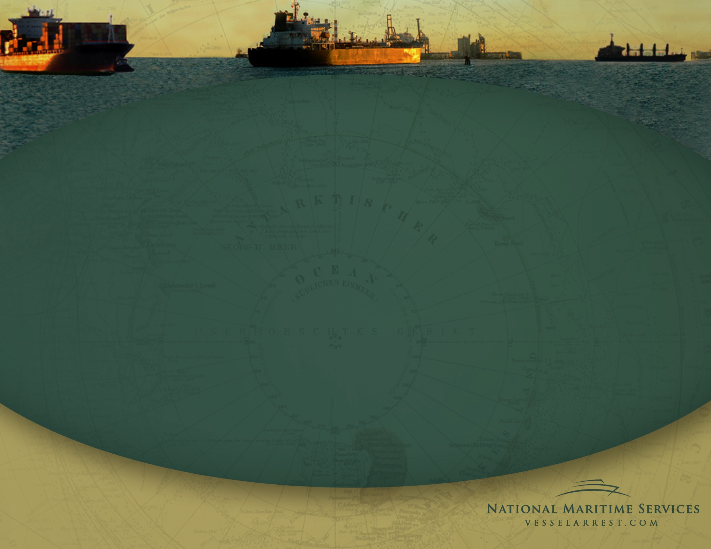
Ship Arrest
Effectively Managing Crew & Maintenance Requirements
- Lloyds Maritime Academy -
London | December 2, 2011 | G. Robert Toney
Notes:
Move logo to bottom rh corner

Slide 2
Introduction
National Maritime Services is a global leader in the management of custody assignments for arrested and seized vessels. The company possesses significant experience in the foreclosure, arrest , attachment and ultimate liquidation of commercial ships and pleasure yachts in a multitude of jurisdictions. This service enables lenders and other claimants to maximize their financial return when vessel arrest becomes necessary.
The company’s affiliate, National Liquidators, is the largest pleasure boat recovery and remarketing provider in the world.
Combined, the enterprise processes approximately 2,000 assignments annually.

Slide 3
Preliminary Arrest Evaluation
  Cost vs. return
  Amount of mortgage/claim
  Vessel condition & value
  Resource requirements
  Other known or potential claims
  Jurisdiction/location of vessel
  Owner’s likely action/inaction
Arrest alternatives
Self-help recovery
    Relocate to preferred jurisdiction
    Requires consent of authorities/crew
Loan note enforcement
    Attach alternate assets
Involuntary bankruptcy

Slide 4

Custody Assignment Goals
  Ensure safety of vessel & crew
  Enhance/preserve value
  Control costs
Notes:
Bullet points, not checkmarks

Slide 5
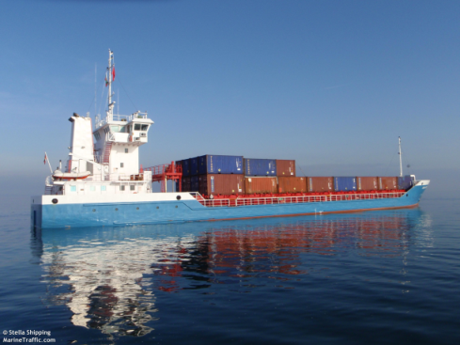
Arrest Services
  Overall arrest planning
  Watchman/keeper & security
  Crew assessment & repatriation
  Provisions, stores, bunkers & waste removal
  Cargo & passenger discharge
  Dockage/berthing & shifting
  Interaction with authorities
  Maintain classifications/certifications
  Insurance

Slide 6

Crew Evaluation
  Loyalty of master & crew
  Immigration status
  Ongoing medical issues
  Pay/contract status
  Security concerns
  Identify non-essential crew

Slide 7

Insurance Issues
      Prior/existing coverage
        Status of existing premiums/calls
        Affect of arrest/seizure
        Name additional insured
      Replacement coverage
        Custodian’s liability
        Port risk, P&I, pollution
        Limited term

Slide 8
Cost Saving Opportunities
Reduce or eliminate existing crew
Utilize watchman in lieu of security service
Negotiate for required services
Move vessel to/from anchorage/berth
Adjust insurance coverage
Eliminate unnecessary services
Pendency of Arrest
C
o
s
t
Time

Slide 9
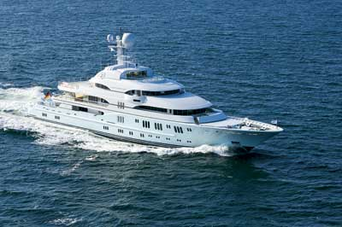
Yacht Foreclosure
    No business value
    Similar complexities to a commercial ship
    Consider self-help vs. judicial foreclosure
    Significant storage, maintenance & crew
    Market evaluation
    Sales strategy

Slide 10
Custody Case Examples

Slide 11
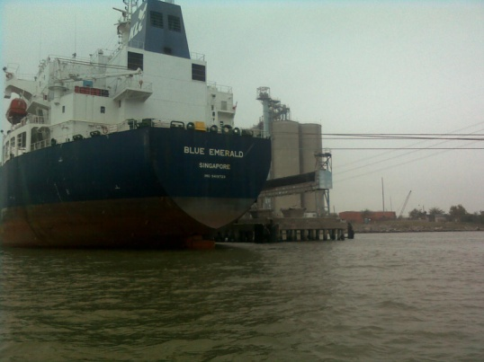
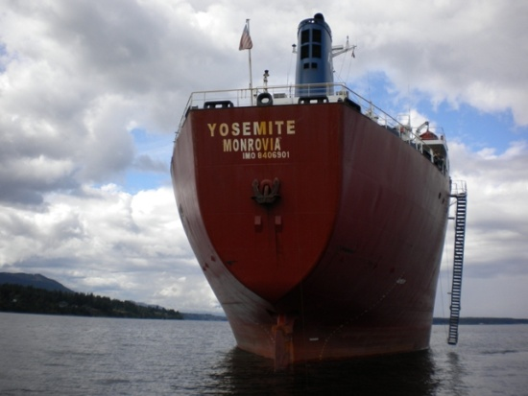
M/V Blue Emerald Arrest
      51,332 dwt product tanker, 2009 build, Singapore registry
      Ship mortgage foreclosure - Korea Line (Singapore)
      Included in Chapter 15 filing
      Reduced crew to minimum safe manning
      Arranged short-term port risk insurance and P&I coverage
      Negotiated less-expensive berth
      Resolved complicated crew pay issues - diverse group of claimants
      Managed crew injury claim – maintenance & cure
      Assisted in vessel transfer to new buyer

Slide 12
M/V Yosemite Arrest
      28,019 dwt bulk carrier, 1985 build, Liberian flag
      Ship mortgage foreclosure relating to Eastwind bankruptcy
      Vancouver, Canada location
      Significant interaction with Canadian authorities and ITF
      Replaced key officers and unnecessary crew
      Maintained Nippon Kaiji Kyokei (“NK”) class certification
      Utilized crew to make ship “sale ready”
      Oversaw court sale, staffed auction

Slide 13
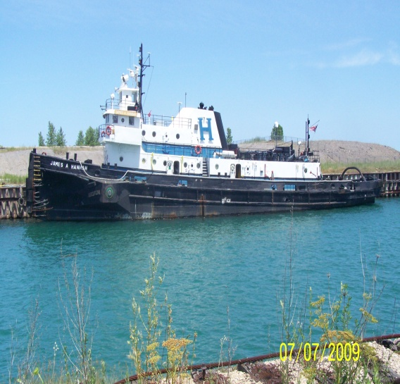
Hannah Marine Fleet
      Fleet of 12 tugs & 9 barges
      Retained by mortgagee bank
      Collateral located in 4 various states
      Cooperative owner surrendered vessels
      Other liens required arrest and subsequent
      marshal sale to cleanse title
      National provided security, dockage,
      maintenance and port risk cover

Slide 14
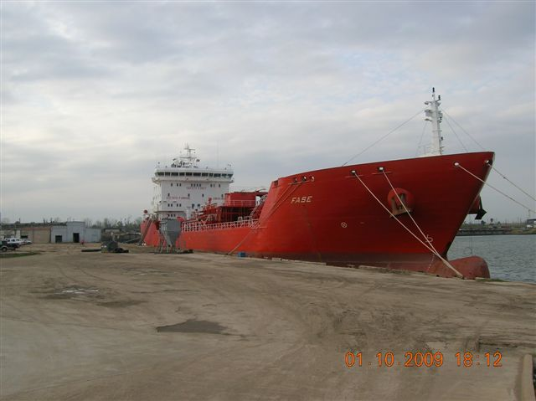
M/T Fase Arrest
      16,750 dwt combined oil & chemical tanker, 2004 build, Liberia flag
      Ship mortgage foreclosure
      Required bio-diesel cargo offload/hired additional AMO crew
      Completed life raft certification to enhance value
      Sold $26+ million

Slide 15
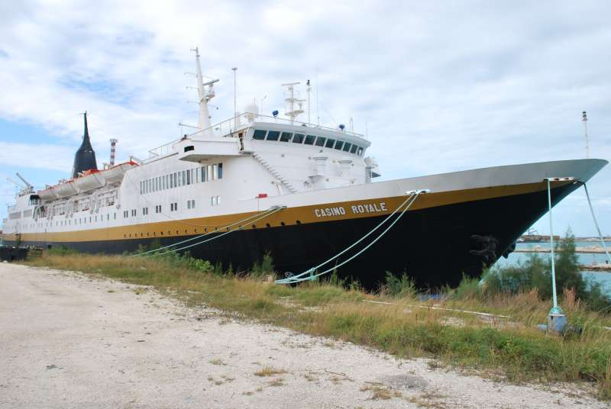
M/V Casino Royale Arrest
      178 cabin gaming cruise ship, 1975 build, Bahamas flag
      Located in Bahamas/retained by Bahamian Admiralty Marshal
      Required significant interaction with Bahamian government
      Alternative claims to gaming equipment
      Repatriated unnecessary crew
      Vessel ultimately sold as scrap

Slide 16
F/V Lady Elizabeth Recovery
      35 meter commercial fishing vessel, 2000 build, US flag
      Retained by mortgagee bank
      Self-help recovery, Costa Rica
      Negotiated release from other Costa Rican claimants
      Relocated to favorable jurisdiction for judicial arrest & court sale

Slide 17
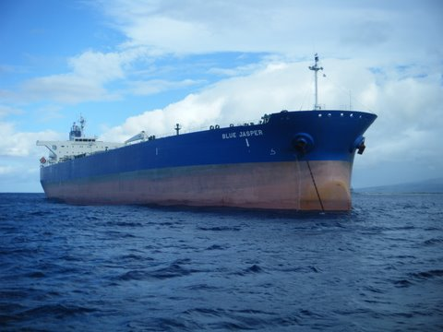
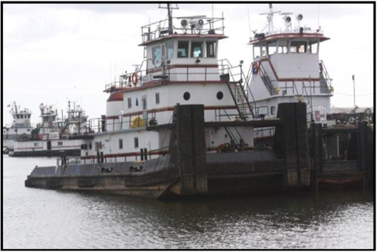
Representative Ship Sales
M/T Blue Jasper
105,905 dwt Aframax tanker
NMS court-appointed custodian
Collaborative sales effort with S&P broker
Hired by mortgagee to validate commercial
reasonableness of sale
$42.5 million sales price
Accumarine Assets
5 Inland push boats
8 Dbl skin tank barges
2 locations (AL & TX)
Sold at auction & post-sale
6 different buyers
$7 million+ cumulative price

